Slide 1
BOXIFY
Customer Churn Analysis & Retention Strategy
Prepared By: Anurag Das

Slide 2
Business Overview
WHAT IS BOXIFY?
D2C E-commerce platform
SUBSCRIPTION MODEL
Flat monthly fee

Slide 3
Objective
Reduce Subscriber Churn
Identify High Risk Segments
Maximize Customer Lifetime Value(CLV)

Slide 4
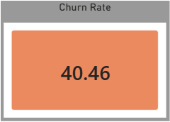
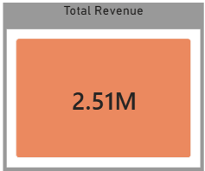
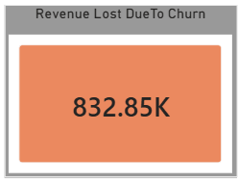
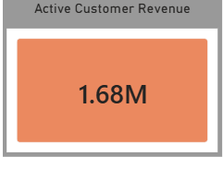
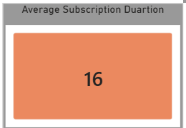
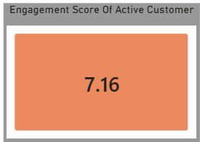
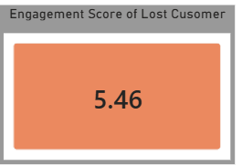
Core KPIs

Slide 5
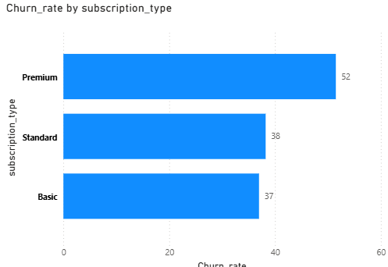
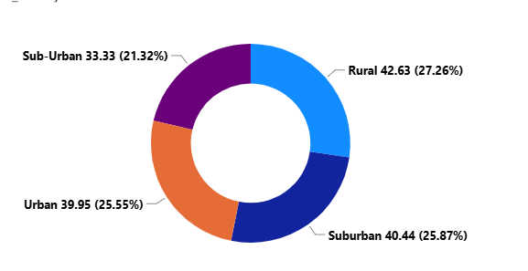
High-Risk Customer Segments: Tier & Location
Tier Risk: Premium subscribers have the highest churn rate (52%), followed by Standard (38%) and Basic (37%).
Location Risk: Churn is distributed across regions—Rural (42.63%), Suburban (40.44%), Urban (39.95%), and Sub-Urban (33.33%).

Slide 6
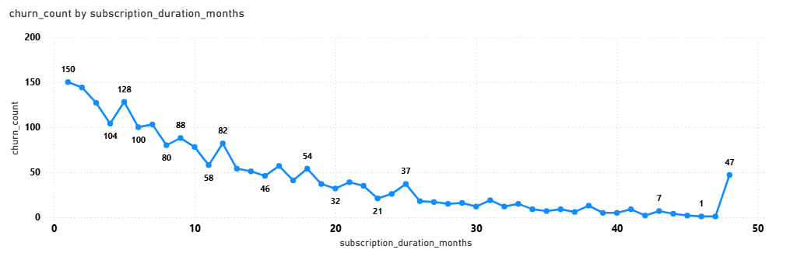
Subscriber Tenure
Churn peaks at Month 1 (150 cancellations) and stays elevated through the first year before tapering off after Month 25.

Slide 7
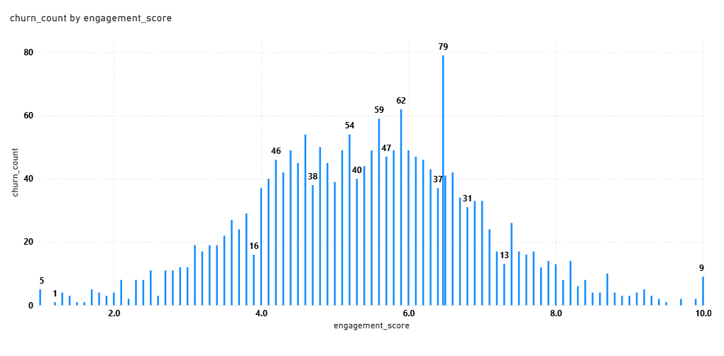
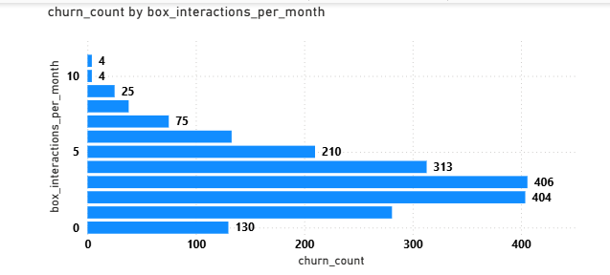
Behavioral Drivers: Engagement & Box Interactions
Interaction Impact: Churn is heavily concentrated among users with low-to-moderate activity, peaking at 2 to 3 box interactions per month (over 400 churned users each).
Engagement Threshold: Churn clusters around mid-range engagement scores between 4.0 and 6.5, peaking sharply at an engagement score of 6.5 (79 cancellations).

Slide 8
Recommendations
Fix Early Onboarding (Months 1–6): Target and reduce the critical early drop-off, starting with Month 1 (150 churned users).
Boost Box Interactions: Focus retention campaigns on low-activity users completing only 1 to 3 box interactions per month.
Protect At-Risk Subscribers: Target interventions at mid-range engagement scores (4.0–6.5) and re-evaluate Premium tier retention (52% churn)

Slide 9
Measuring Impact
Weekly Operations Dashboard: Track weekly box customization rates to push users beyond the vulnerable 1–3 monthly interaction zone.
Monthly Engagement & Churn Watch: Monitor subscribers falling in the 4.0–6.5 engagement band and address early drop-offs within the first 6 months.
Quarterly Revenue Impact: Work toward lowering the overall churn rate from 40.46% to recover a portion of the $832.85K lost revenue.

Slide 10
THANK YOU

